Slide 1
KDD CUP 2018
M10615074@ 黃偉翔
M10615086@ 游勤葑

Slide 2
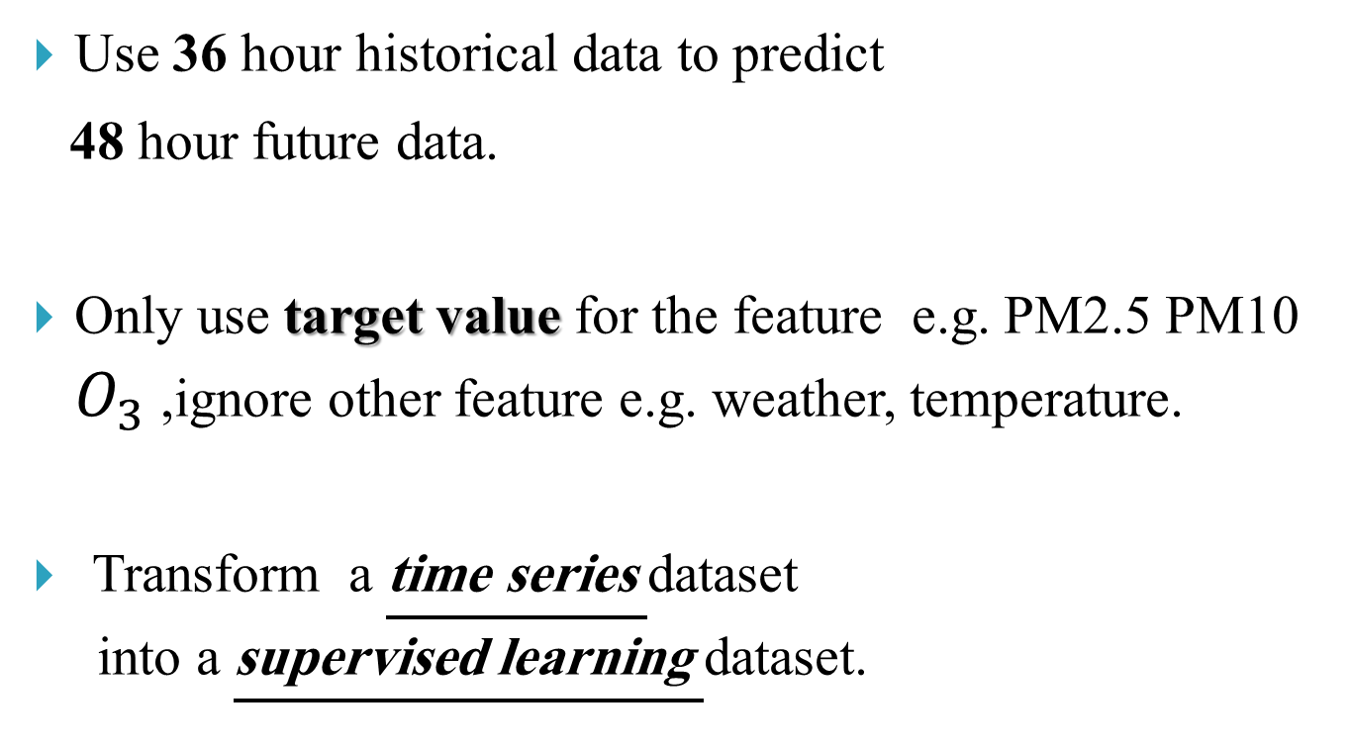
Phase 1
Use 36 hour historical data to predict
48 hour future data.
Only use target value for the feature e.g. PM2.5 PM10 $O_{3}$ ,ignore other feature e.g. weather, temperature.
Transform a time series dataset
into a supervised learning dataset.

Slide 3
1
2
3
4
5
6
X Y
1 2
2 3
3 4
4 5
5 6

Slide 4
Tool
TensorFlow.
Long Short-Term Memory(LSTM)

Slide 5
Problem
Model is good at rate of convergence,
but the ability of fitting data is not good enough.

Slide 6
Phase 2 Planning
Use more feature like weather, temperature, pressure, humidity.
Build a model for each station or a little group of stations.

Slide 7
Result
Public Score:1.24598187459
Ranking: 209

Slide 8
Question?

